Slide 1
SSD: Single Shot MultiBox Detector
Jaeman Han

Slide 2
Introduction
The core of SSD
predicting category scores and box offsets for a fixed set of default bounding boxes using small convolutional filters applied to feature maps
produce predictions of different scales from feature maps of different scales, and explicitly separate predictions by aspect ratio.
These design features lead to simple end-to-end training and high accuracy, even on low resolution input images, further improving the speed vs accuracy trade-off.

Slide 3
Introduction
SSD is simple relative to methods that require object proposals
The fundamental improvement in speed comes from eliminating bounding box proposals and the subsequent pixel or feature resampling stage.
faster than the previous state-of-the-art for single shot detectors (YOLO)
as accurate as slower techniques that perform explicit region proposals and pooling
(including Faster R-CNN).

Slide 4
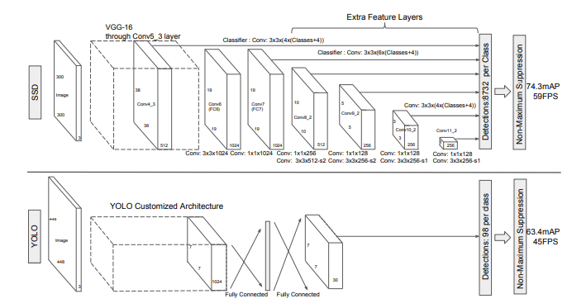
Model
Multi-scale feature maps for detection
These layers decrease in size progressively and allow predictions of detections at multiple scales.
Convolutional predictors for detection
The convolutional model for predicting detections is different for each feature layer
YOLO that operate on a single scale feature map
예측된 Output은 class, category 점수와, default box에 대응되는 offset을 구함

Slide 5
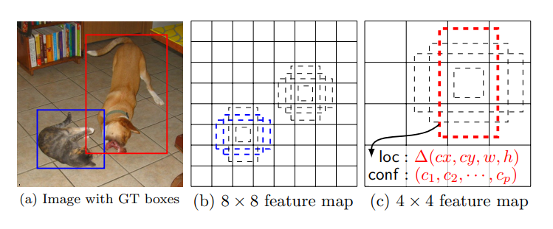
Model
Default boxes and aspect ratios
We associate a set of default bounding boxes with
each feature map cell
Allowing different default box shapes in several feature maps let us efficiently discretize the space of possible output box shapes.
This results in a total of (c + 4)k filters that are applied around each location in the feature map, yielding (c + 4)kmn outputs for a m × n feature map

Slide 6
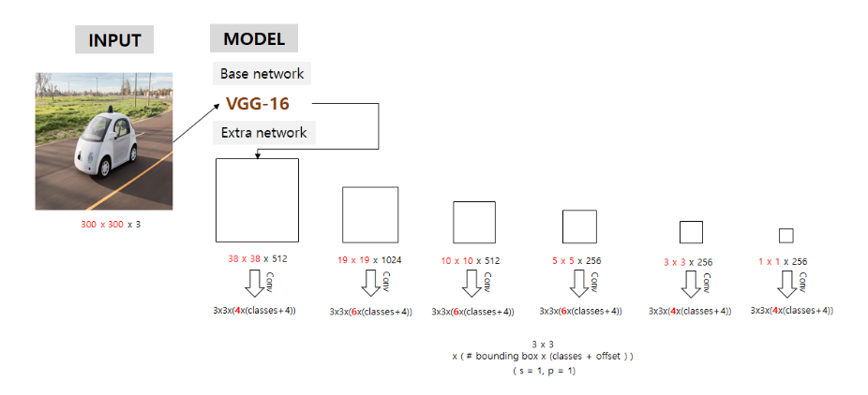
example

Slide 7
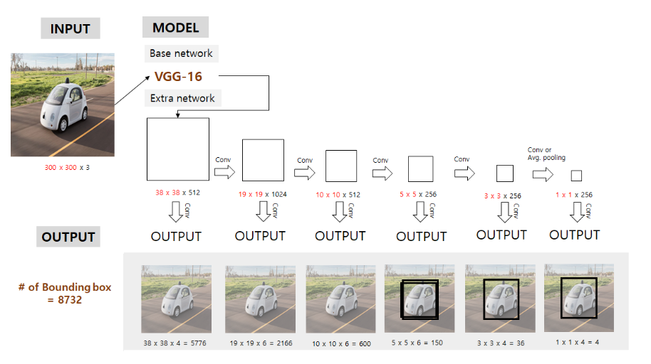
example

Slide 8
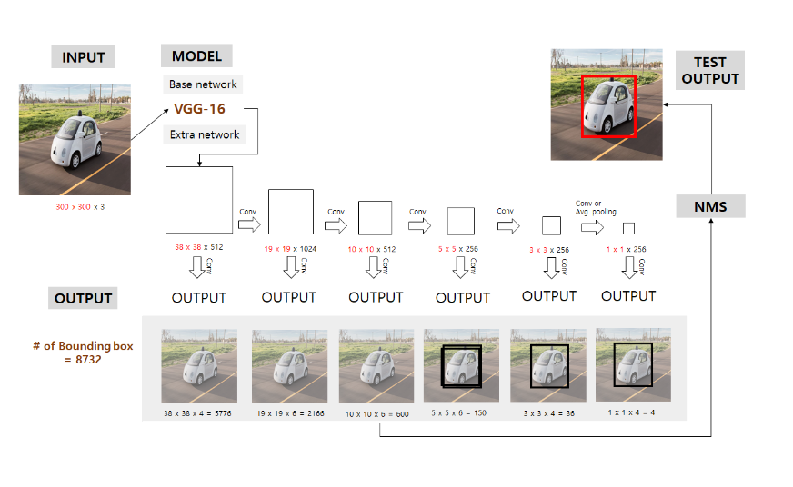
example

Slide 9
Training
the loss function and back propagation are applied endto-end
choosing the set of default boxes and scales for detection
the hard negative mining and data augmentation strategies.

Slide 10
Matching strategy
determine which default boxes correspond to a ground truth detection and train the network accordingly.
For each ground truth box we are selecting from default boxes that vary over location, aspect ratio, and scale.
we match default boxes to any ground truth with jaccard(=IOU) overlap higher than a threshold (0.5, labeling positive or negative ).
Hard negative는 뒤에

Slide 11

Training objective
The overall objective loss function is a weighted sum of the localization loss (loc) and the confidence loss (conf):
N is the number of matched default boxes.( If N = 0, wet set the loss to 0.)
$α$ : balancing parameter

Slide 12
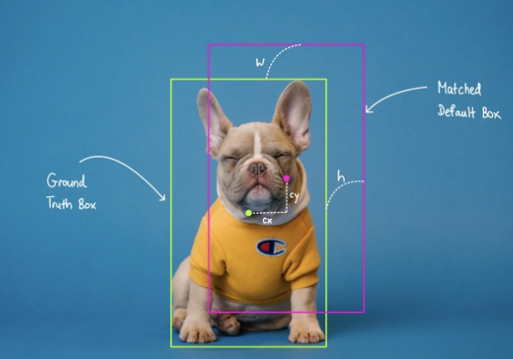
Training objective
localization loss
L_loc is the the sum of Smooth L1 loss across all bounding box properties (cx, cy, w, h) for matched positive boxes.
This means that it does not take into account default boxes whose classes are the background class or default boxes that do not matched with any ground truth boxes.

Slide 13
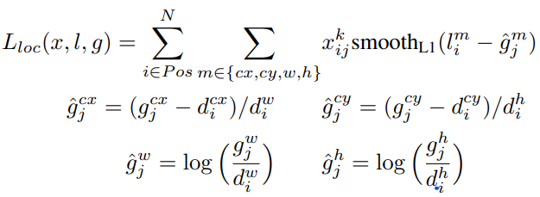
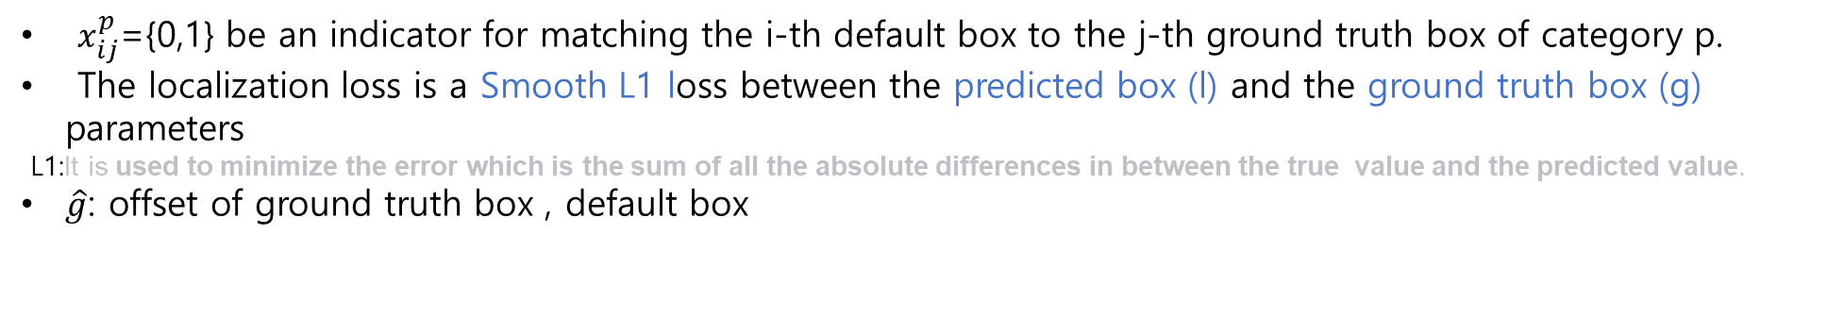
Training objective
localization loss
$x_{ij}^{p}$={0,1} be an indicator for matching the i-th default box to the j-th ground truth box of category p.
The localization loss is a Smooth L1 loss between the predicted box (l) and the ground truth box (g) parameters
L1:It is used to minimize the error which is the sum of all the absolute differences in between the true value and the predicted value.
$\hat{g}$: offset of ground truth box , default box

Slide 14
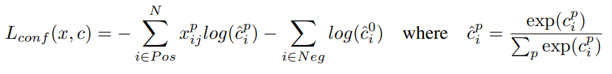
Training objective
The confidence loss is the softmax loss over multiple classes confidences (c)

Slide 15
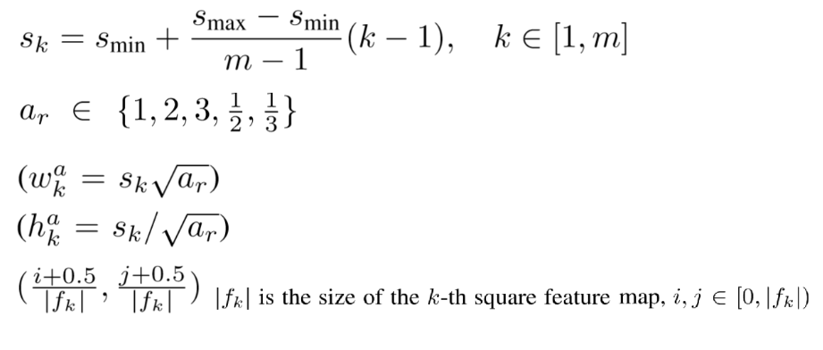
Choosing scales and aspect ratios for default boxes
To handle different object scales, other methods process the image at different sizes and combining the results afterwards
by utilizing feature maps from several different layers in a single network for prediction we can mimic the same effect
improve semantic segmentation quality because the lower layers capture more fine details of the input objects

Slide 16
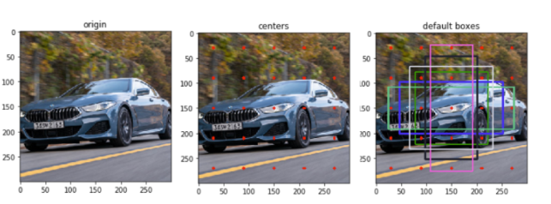
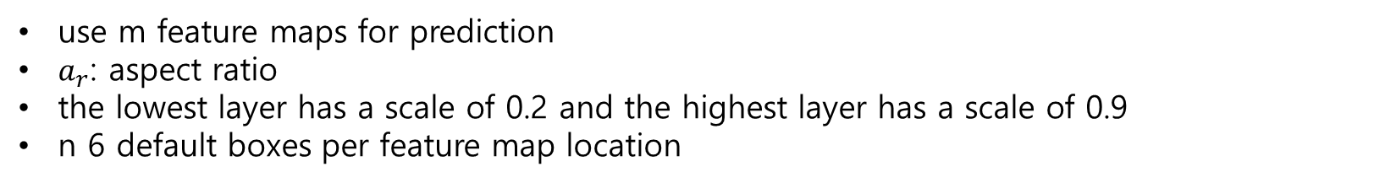
Choosing scales and aspect ratios for default boxes
use m feature maps for prediction
$a_{r}$: aspect ratio
the lowest layer has a scale of 0.2 and the highest layer has a scale of 0.9
n 6 default boxes per feature map location

Slide 17
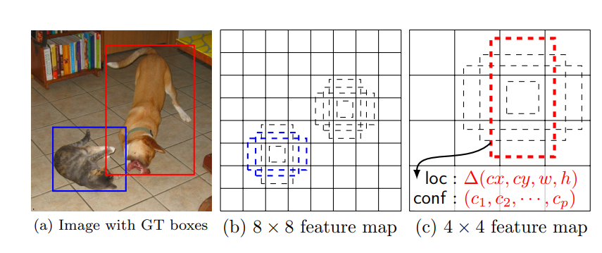
Choosing scales and aspect ratios for default boxes

Slide 18
Hard negative mining
After the matching step, most of the default boxes are negatives
significant imbalance between the positive and negative training examples
sort them using the highest confidence loss for each default box and pick the top ones
positive : negative = 1:3
Data augmentation
To make the model more robust to various input object sizes and shapes, each training image is randomly sampled
Use the entire original input image.
Sample a patch so that the minimum jaccard overlap with the objects is 0.1, 0.3, 0.5, 0.7, or 0.9.
Randomly sample a patch.

